Slide 1

Portfolio Project: Analyses of Customer Service Data using Microsoft Excel

Slide 2


Slide 3
Business Understanding
The analysis aims to leverage data-driven approaches to optimize customer service processes, enhance customer experience, and drive overall business growth. By examining historical customer service data, the project seeks to identify patterns, trends, and opportunities for improvement, ultimately leading to enhanced customer loyalty and increased operational efficiency.
Scope: the analysis will focus on the provided customer service data from Nile, covering aspects such as sentiment, customer satisfaction scores, reasons for calls, communication channels, and response times. The insights generated will guide Nile in making informed decisions to enhance its customer service operations.

Slide 4
Data Understanding
Data Description:
The provided dataset includes the following attributes:
Id: Unique Customer ID
customer_name: Name of the customer
sentiment: Sentiment of the customer (Neutral, Positive, Very Positive, Negative, Very Negative)
csat_score: Customer Satisfaction Score (Scale of 1 to 10)
call_timestamp: Date and time of the customer's call
call_day: Day of the call (1 represents the 1st day of the month, and so on)
reason: Reason for the customer's call (Billing Question, Service Outage & Payments)
city: City to which the customer belongs
state: State to which the customer belongs
channel: Mode of communication used by the customer (Call-center, Chatbot, Email, Web)
response_time: How fast the customer request was serviced (Above SLA, Below SLA, Within SLA)
call duration in minutes: Duration of the call
call_center: Location of the call center where the service request was handled.

Slide 5
Data Preparation
Before analysis, data cleaning and validation are important for more accuracy and consistency.
Null and duplicate values are checked.
Added call_day column for analysis purpose.
Now the dataset is ready for further analysis.

Slide 6

Tools The analysis will be conducted using microsoft excel, providing a familiar and accessible platform for data manipulation, visualization, and interpretation.

Slide 7
Data Analysis
Total Calls = 32941
Average calls per day = 1062
Average Call Duration = 25.02

Slide 8
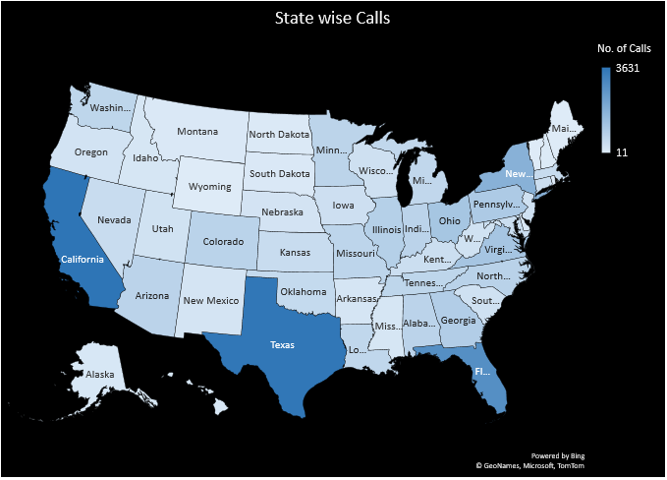
State wise Calls
On the basis of above table and graph we
can conclude that the maximum number of
calls/complaints are from California followed
by Texas, Florida, New York, Virginia, etc.
And Wyoming, Vermont & Maine these are the states from which we received a very small number of complaints.

Slide 9
Customer Sentiment Analysis
The customer sentiment (Positive, Negative and Neutral) analysis is done using above graph to understand satisfaction level and we can observe that negative sentiment is high.
.

Slide 10
Root Cause Analysis
From the above graph we can say that the mostly customers have issues in billing
followed by payment issues and service outage.
So try to understand why customers have issues with billing and need to resolve it.

Slide 11
Service Response Time Analysis
Response time is nothing but how fast the customer request was serviced and from this pie chart we can state that the maximum number of complaints or the customer request are resolved or serviced Within SLA.

Slide 12
Customer Segmentation
This donut chart shows that the most preferred calling channel is Call Center followed by Chatbot, Email and Web

Slide 13
Recommendation
Here are some insights which guide nile in making informed decisions to enhance its customer service operations.
Large number of calls for queries and support requests were from california and texas so here our main focus is to enhance customer service operation in these states.
Performed sentiment analysis on customer interactions to understand overall satisfaction levels and it is identified that the customers with negative sentiment are maximum. It means that they are facing issues while processing .
The main reason behind the customers calls is billing question. To address this problem company needs to improve there billing procedure. Some customers were having payment issues and service outage problem. So also try to improve payment procedure.
After analyzing response times for customer queries and support requests it is observed that the maximum number of queries were resolved within sla. But try minimize the duration for those complaints were resolved above SLA.
Need to work on the reasons due to which calls are high and satisfaction level is low.

